Slide 1
Inflammatory Bowel disease: Ulcerative Colitis
Sarah Hallaj
May 24th 2010

Slide 2
Outline
Present my patient
Nutrition assessment
Tests
Ulcerative colitis
Trivia questions
Nutrition focused physical examination: PICTURES!
Nutrition intervention, monitoring & evaluation

Slide 3
Nutrition Assessment

Slide 4
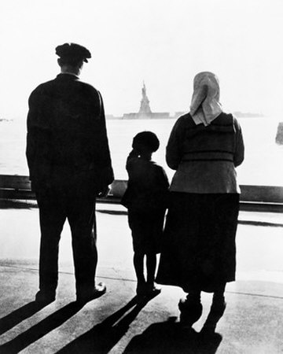
Client history
Social history: 28 year old white male who migrated from Ukraine, Eastern Europe with the rest of his family. He was a carpenter but is now unemployed with no insurance. He lives with his 2 sisters who usually do the cooking at home. His parents and brother were present at his hospital stay.
Notes:
While the patient was sleeping, his brother would translate to his parents

Slide 5
Admit date: 2/3/2010
Chief complaint:
Diarrhea ( hematochezia: bloody soft stools) & weight loss of 23kg in 2 ½ months
Initial diagnosis:
Anal fissure & cachexia
Notes:
So we got a physician’s consult at the dietitian’s office to see this patient due to wt loss and low body wt
Hematochezia is commonly associated with bleeding in the lower GI tract

Slide 6
Outpatient gastroenterology consultation
Patient became ill in November 2009 with slow progressive worsening of his symptoms
Patient was having over 15 bowel movements a day, sometimes awakening him from sleep at night
He noted his inability to eat and eventually lost 23 kg
Stool studies were negative for any enteric pathogens, C. Diff, and Giardia antigen
Endoscopic evaluation was consulted but refused because of financial concerns and anxiety about consequences of the test
Notes:
Patient did not experience any nausea, vomiting, chills or fevers
No skin changes
In November pt albumin was 3.3, normal

Slide 7
Medication list in November 2009
Mesalamine : anti-inflammatory (for ulcerative colitis or Cronh’s disease), oral
Rowasa enemas: anti-inflammatory (for ulcerative colitis or Cronh’s disease), rectal
Prednisone (corticosteroids): anti-inflammatory, immunosuppressant
Loperamide: anti-diarrheal
Sulfasalazine: treats RA or rectal bleeding and diarrhea from ulcerative colitis
Notes:
All these medications did not provide any benefits to the patient’s symptoms

Slide 8
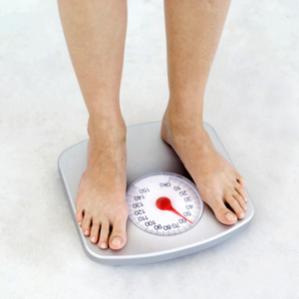
Anthropometric measurements
Height: 6ft 0in Weight: 48.44 kg
BMI: 14.5
IBW: 72.3 kg % IBW: 67 %
Weight history: 72 kg in November 2009
33 % of weight loss in 2 ½ months
➔ ICD-9 code

Slide 9
Malnutrition coding reference from Providence Health & Service
ICD-9 Code: Other severe, protein-calorie malnutrition:
Criteria | Currently at:
Weight < 85% | 67% of IBW
Severe weight loss >7.5% in 3 months | 33 % weight loss in 2 ½ months
Depressed visceral protein stores | Albumin 2.4 mg/dL Prealbumin 11 mg/dL
Signs of muscle wasting | Arms, legs, chest, and temples
Underweight, BMI <19 | BMI: 14.5

Slide 10
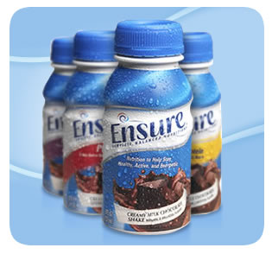
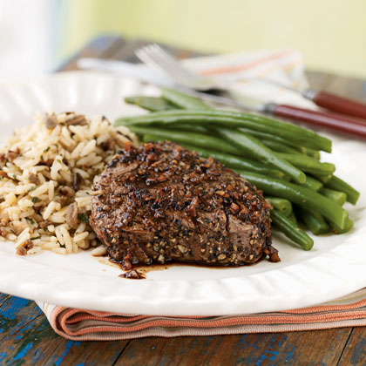
Food/nutrition-related history
Prior to Nov. 09 patient was consuming over 2500 kcal/day
Prior to hospitalization patient would consume mom’s cooked meals 5-6 small meals ~ 1300-1400 kcal/day
Due to inadequate oral intake, added ensure supplement and started patient on calorie count
Notes:
He reported that he was much stronger and had energy.
Avoids dairy products due to intolerance
How many of you used calorie counts in your hospital?

Slide 11
Estimated Energy requirements
Using the Mifflin equation: 1650 kcal (34 kcal/kg)
Added 200 kcal for weight gain
Total = 1850 kcal/day (38 kcal/kg)
Protein requirements=58.1- 72.7 g/day (1.2-1.5 g/kg )
Notes:
D/C home diet should be around 2150 kcal/day

Slide 12
Biochemical data
Days | PO4 | K+ | Mg | Albumin | Prealbumin | Hemoglobin | Weight (kg)
Day 2 2/4/10 |  |  |  | 2.4 | 11.0 | 10 | 48.44
Day 3 2/5/10 | 2.2 | WNL | WNL |  |  |  | 49.2
Day 5 2/7/10 | WNL | WNL | WNL |  |  |  | 50.00
Day 6 2/8/10 | 3.6 | 4.2 | 1.8
Day 8 d/c 2/10/10 | 3.2 | 4.3 | 2.3 | 2.4 | 11.0 | 10.6
Reference range | PO4 mg/dL | K+ mmol/L | Mg mg/dL | Albumin mg/dL | Prealbumin mg/dL | Hemoglobin gm/dL
 | 2.3-4.7 | 3.7-5.5 | 1.7-2.5 | 3.2-4.9 | 18-32 | 13.2-16.2
Notes:
Total of 1.56 kg weight gain in 5 days
On day 2 (2/5/10) glucose was 135

Slide 13
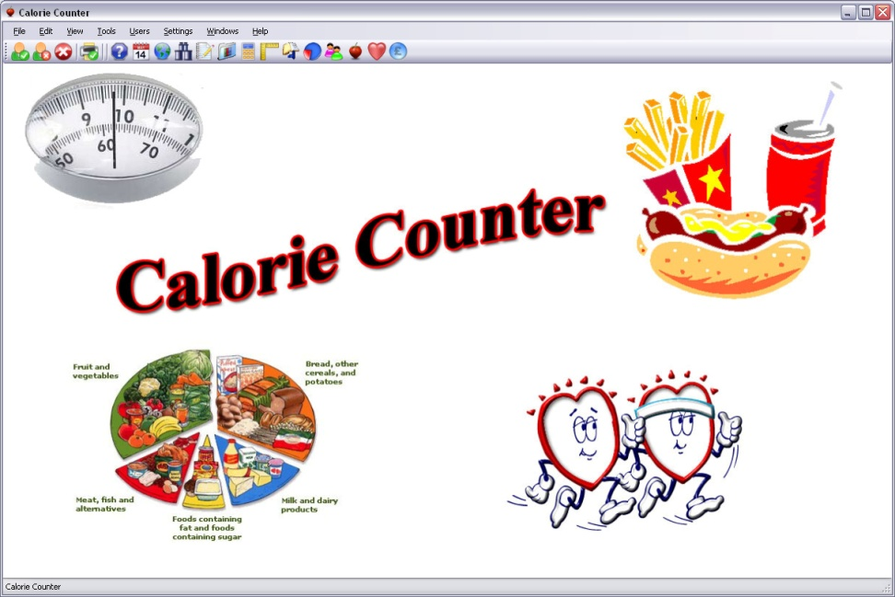
Calorie count
Hospital day 2: 844 kcal/day & 27 gm Pro
Hospital day 3: 2947 kcal & 116 gm Pro
Hospital day 4: 2872 kcal & 117 gm Pro
Hospital day 5: 3000 kcal & 97 gm Pro
Current diet order: General
Notes:
As pt started consuming large amounts of calories we were concerned about risk of refeeding syndrome

Slide 14
Refeeding syndrome
Is defined as: severe electrolyte and fluid shifts associated with metabolic abnormalities in malnourished patients refeeding either orally, parentally or enterally.
Due to patient’s low phosphorus, he was at risk of refeeding syndrome
Notes:
Refeeding syndrome was first described in WWII in prisoners who exhibited cardiac and neurological abnormalities with commencement of feeding after long periods of starvation.
Potentially fatal!
The 3 major electrolytes that we check are…

Slide 15
Tests:
Sigmoidoscopy
Magnetic Resonance Elastography (MRE)
Chest x-ray: normal
Human immunodeficieny virus (HIV): negative
Hepatitis B surface antigen: non-reactive
Stool output: no ova or parasites
Quantiferon gold: false positive (BCG vaccination)
TSH & T4: WNL
Fecal fat test: negative

Slide 16
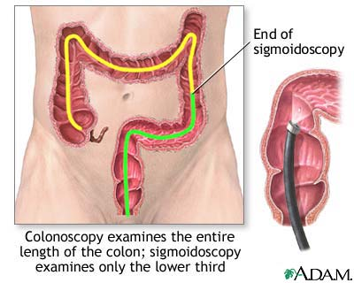
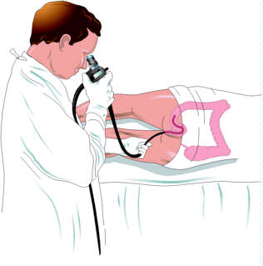
What is Sigmoidoscopy?
Is when a doctor inserts an endoscope (a long, flexible, lighted tube connected to a computer and TV monitor) into the anus to see the inside of the colon and rectum. The doctor will be able to see any inflammation, bleeding, or ulcers on the colon wall.
Notes:
A colonoscopy or sigmoidoscopy are the most accurate methods for making a diagnosis of ulcerative colitis and ruling-out other possible conditions, such as Crohn’s disease, diverticular disease, or cancer
Sometimes x rays such as a barium enema or CT scans are also used to diagnose ulcerative colitis or its complications.
http://www.nlm.nih.gov/medlineplus/ency/images/ency/fullsize/1083.jpg

Slide 17
What is Magnetic Resonance Elastography (MRE)?
Phase-contrast-based MRI imaging technique that can directly visualize and quantitatively measure propagating acoustic strain waves in tissue-like materials subjected to harmonic mechanical excitation.
Produces color-coded images known as elastograms that indicate tissue elasticity or stiffness.
This is significant because during a physical examination, palpation can be effective in detecting tumors, but is restricted to parts of the body that are not accessible to the physician’s hand.
Notes:
MRE shows as a potential technique for ‘palpation by imaging’
MR enterogram used to rule out small bowel disease to help differentiate Crohn’s and ulcerative colitis
Possible colectomy was discussed with patient?
No obvious fistula

Slide 18
Results
Sigmoidoscopy showed severely inflamed tissue up to 40cm and 3 circular punched out ulcers in the rectum
MRE showed gastric distention & thick-walled inflamed rectosigmoid colon
Notes:
Through sigmoidoscopy was not able to visualize the base of the “ 3 circular punched out ulcers” (due to severe inflammation)
Some linear areas with of denuded mucosa with other areas coarse nodularity and cobblestoning
Per MD patient was not malabsorbing

Slide 19
MD Diagnosis
Inflammatory bowel disease
Ulcerative colitis
Notes:
After all these test that were done throughout the patient’s hospital stay
Will require IV fluids, and closely monitoring to make sure he doesn’t develop toxic megacolon (deadly)

Slide 20
Inflammatory Bowel Disease (IBD)
Is a general name for diseases that cause inflammation in the small intestine and colon. It can be difficult to diagnose because its symptoms are similar to other intestinal disorders.
Two types of IBD include: ulcerative colitis and Crohn’s disease
Notes:
Over 1 million Americans are afflicted with IBD.
Treatment cost in the US for patients with IBD exceeds $1.7 billion/year
Crohn’s disease causes an inflammation of the lining of digestive tract. It causes severe abdominal pain, diarrhea and lead to malnutrition. The inflammation spreads deeper into the layers of affected tissue.

Slide 21
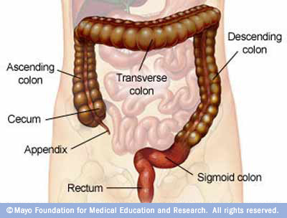
What is ulcerative colitis
Is a disease that causes chronic inflammation and ulcers in the lining of the rectum and colon. Ulcers form where inflammation has killed the cells that usually line the colon, then bleed and produce pus.
Inflammation in the colon also causes the colon to empty frequently, causing diarrhea and abdominal pain.
Notes:
There are theories on causes of ulcerative colitis People with ulcerative colitis have abnormalities of the immune system. Some interaction of the GI immunologic system and genetic & environmental factors. But doctors don’t know if these abnormalities are a cause or result of the disease.

Slide 22
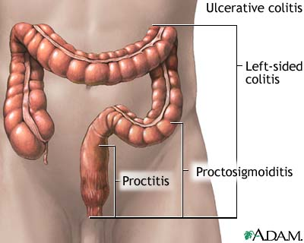
When the inflammation occurs in the rectum and lower part of the colon it is called ulcerative proctitis. If the entire colon is affected it is called pancolitis. If only the left side of the colon is affected it is called left-sided or distal colitis.

Slide 23
Symptoms of ulcerative colitis
Anemia
Fatigue
Weight loss
Loss of appetite
Rectal bleeding
Loss of body fluids and nutrient => diarrhea
Skin lesions
Joint pain
Growth failure (esp. in children)
Notes:
About ½ of the people diagnosed with ulcerative colitis have mild symptoms. Others suffer frequent fevers, bloody diarrhea, nausea, and severe abdominal cramps. Ulcerative colitis may also cause problems such as arthritis, inflammation of the eye, liver disease, and osteoporosis. It is not known why these problems occur outside the colon. Scientists think these complications may be the result of inflammation triggered by the immune system. Some of these problems go away when the colitis is treated

Slide 24
Ulcerative colitis complications:
Toxic megacolon: life-threatening complication
Cancer
Notes:
Toxic megacolon: rapid widening of part of the large intestine, causing abdominal pain, distention, tenderness, dehydration, fever & shock w/in few days
Patient with ulcerative colitis for 8yrs or longer are at greater risk of getting colon cancer

Slide 25
If all fails…
Surgery to remove part or all of the colon
Removing the entire colon cures ulcerative colitis
Notes:
If severe symptoms persist and medications (corticosteroids, anti-inflammatory, and immunosuppressive agents) don’t help then…

Slide 26
Ileal Pouch-Anal Anastomosis (IPAA):
Allows the patient to have normal bowel movements
http://www.mayoclinic.org/colostomy-sparing-surgery/ipaa.html
Notes:
Removal of the entire colon and rectum
Preservation of the anus & sphincter muscles
Then surgeon constructs a pouch from end of small intestine and attaches directly to the anus
(temporary ileostomy)

Slide 27
IPAA cont’d
IPAA might not be appropriate for each patient
It depends on the severity of the disease & the patient’s needs, expectations and lifestyle

Slide 28
QUESTIONS

Slide 29
Who is affected by ulcerative colitis?
Notes:
Some trivia questions
At what age are people usually affected with ulcerative colitis?!?

Slide 30
Who is affected by ulcerative colitis?
It can occur in people of any age, but usually starts between the ages of 15 and 30, and less frequently between 50 and 70 years of age.
It affects men and women equally and appears to run in families.
A higher incidence of ulcerative colitis is seen in Whites and people of Jewish descent.
Notes:
20% of people with ulcerative colitis have a family member or relative with ulcerative colitis or Cronh’s disease

Slide 31
True or false?
Ulcerative colitis is caused by emotional distress and/or sensitivity of certain food products
Notes:
No, but these factors may trigger symptoms in some people ☺

Slide 32
Nutrition Diagnosis

Slide 33
PES Statements
Inadequate protein-energy intake related to altered GI function as evidenced by altered nutrition-related lab values: albumin 2.4 mg/dL, hemoglobin 10 gm/dL and bloody diarrhea
Malnutrition related to involuntary weight loss as evidenced by 33% weight loss in 2 ½ months & 67% IBW

Slide 34
Nutrition-focused physical findings
Physical appearance
Muscle and fat wasting: temple, chest and extremities
Notes:
Appetite was improving as intake was significantly increasing as well as weight

Slide 35
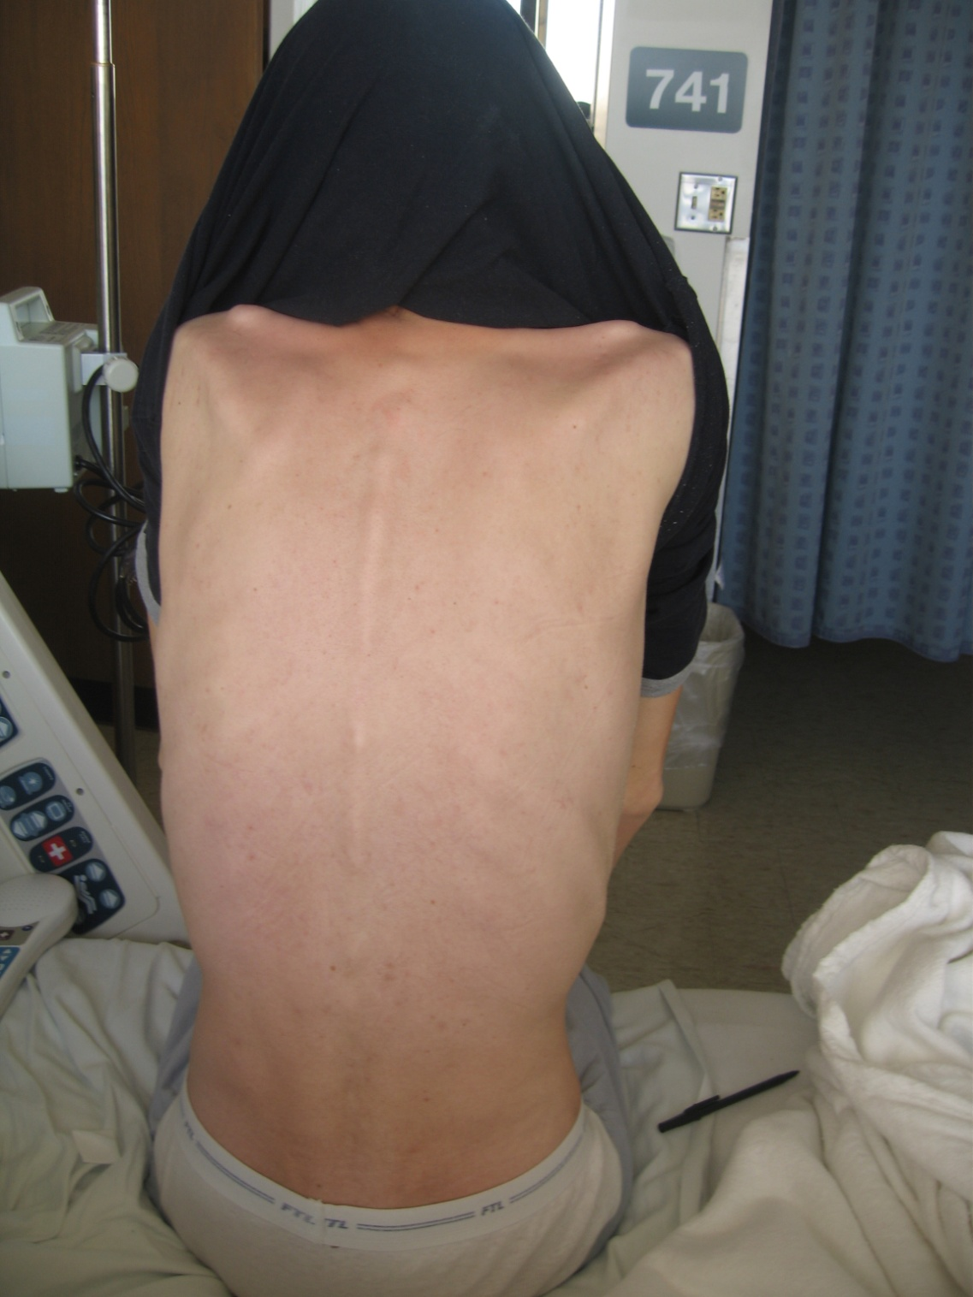

Slide 36
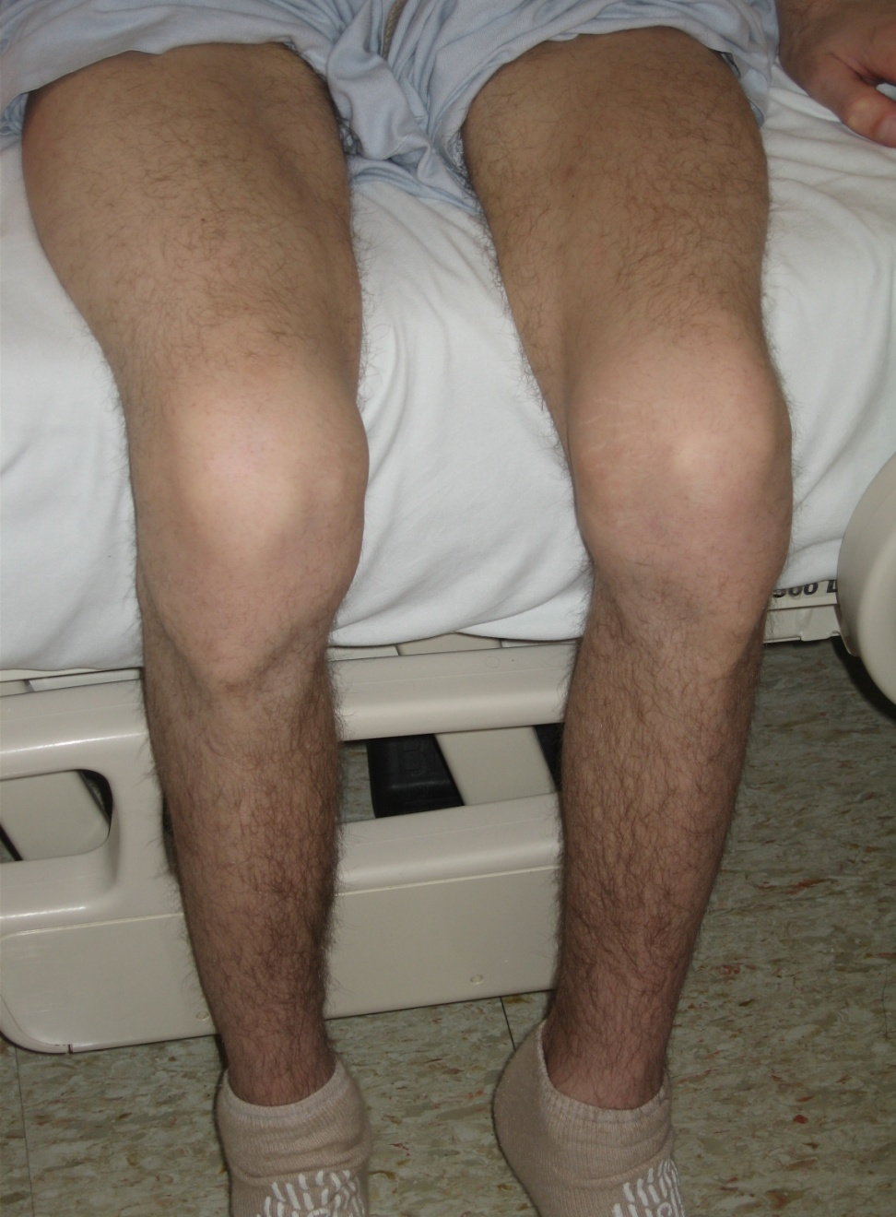

Slide 38
Nutrition Intervention
Placed calorie count order
Added ensure supplement
Nutrition education: educated patient on low residue diet per MD order and provided handout from American Dietetic Association
Coordination of nutrition care: talked with nurses to assure daily weights
Answered patient’s questions

Slide 39
ADA Low residue diet:
Recommended foods:
Yogurt, cheese, soy milk, rice milk, or almond milk
Tender, ground, & well cooked beef & other protein foods (tofu, fish, eggs, smooth nut butters)
Refined white grains
Well-cooked vegetables
Peeled fruits & fruit juices w/out pulp
Notes:
Don’t confuse: low residue ≠ low fiber
Residue: end result of digestive, secretory, absorptive, and fermentable processes
Limit caffeine to ↓ GI distress

Slide 40
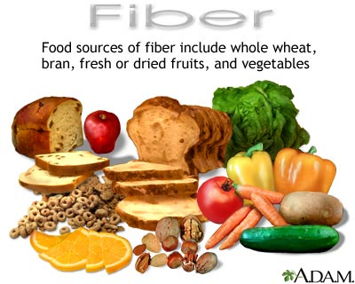
EAL recommends:
Consuming a diet with > 15 g/day of fermentable fiber resulted in improvements in ulcerative colitis
Notes:
Fermentable fiber: germinated barley foodstuffs (GBF), oat bran fiber and ispaghula (psyllium)
Each patient with ulcerative colitis is different. One food might cause a “flare up” for one person but not another. Individualized
Avoid foods that cause symptoms to be worse

Slide 41
Nutrition Monitoring & Evaluation
Completed follow-ups
Monitored electrolytes
Evaluated patient’s diet adequacy & POC

Slide 42
Discharge medication list:
Ciprofloxacin: antibiotic
Prednisone (30 mgx2/day): anti-inflammatory, immunosuppressant
Ferrous sulfate (325 mg) w/ vitamin C: treats iron-anemia deficiency
Remicade (infliximab/etanercept): anti-arthritic, Crohn’s disease/ ulcerative colitis treatment
Notes:
Pt was good candidate for Remicade after 7 days of lack of clinical response. This was ordered in an outpatient setting as pt was d/c to GI clinic for infusion of Remicade which is a more aggressive approach
This is when patient noted subjective improvement in the consistency of his stools, going from watery to more of pudding consistency (still blood in stool though)

Slide 43
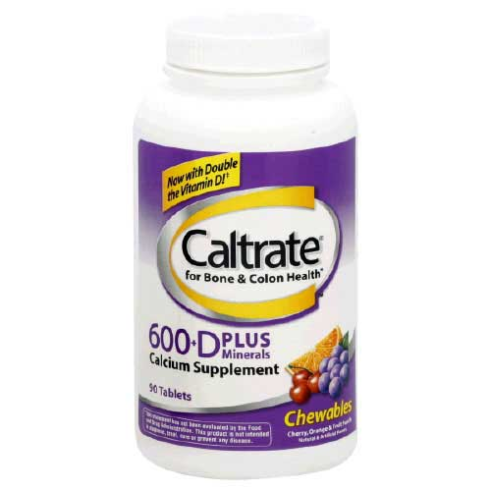
What nutrition interventions would you suggest to address nutrition issues caused by long term use of prednisone?
Suggest including a calcium with vitamin D supplement

Slide 44
References
Refeeding Syndrome- Awareness, Prevention and Management 1:4 (2009): 1495-498. Head and Neck Oncology. BioMed Central, 26 Jan. 2009. Web. 15 May 2010. <http://www.headandneckoncology.org/content/pdf/1758-3284-1-4.pdf>.
Ulcerative Colitis. National Institute of Health, Feb. 2006. Web. 15 May 2010. <http://digestive.niddk.nih.gov/ddiseases/pubs/colitis/>.
Medical Imaging Analysis 5.4 (2001): 237-54. Science Direct. Web. 15 May 2010. <http://www.sciencedirect.com/science?_ob=ArticleURL&_udi=B6W6Y-44HXCK2-3&_user=10&_coverDate=12%2F31%2F2001&_rdoc=1&_fmt=high&_orig=search&_sort=d&_docanchor=&view=c&_searchStrId=1336406594&_rerunOrigin=scholar.google&_acct=C000050221&_version=1&_urlVersion=0&_userid=10&md5=473bd5ffa89813a929eab07fafdb2ad0>.
CANNOM, REBECCA R., et al. "Inflammatory Bowel Disease in the United States from 1998 to 2005: Has Infliximab Affected Surgical Rates?." American Surgeon 75.10 (2009): 976-980. Academic Search Premier. EBSCO. Web. 17 May 2010. http://proxy.library.oregonstate.edu/login?url=http://search.ebscohost.com/login.aspx?direct=true&db=aph&AN=44682704&loginpage=Login.asp&site=ehost-live.
Eat Right. American Dietetic Association, 1 July 2008. Web. 21 May 2010. <http://www.adaevidencelibrary.com/conclusion.cfm?conclusion_statement_id=250903>.
Food Medication Interactions. 15th ed. Birchrunville: Food-Medication Interactions, 2008. Print.
International Dietetics and Nutrition Terminology Reference Manual. 2nd ed. Chicago: American Dietetic Association, 2009. Web. 16 May. 2010. <https://ozone.ohsu.edu/foodandnutritionservices/references/idnt_second_edition.pdf>.
Notes:
http://newsblog.mayoclinic.org/2008/10/27/new-mre-imaging-for-liver-disease/

